Slide 1
SYSC 4907: Oral Presentation
Security Evaluations Management System
Team members:
Zijun Hu 101037102
Tiantian Lin 101095243
Jiawei Ma 101034173
Ruixuan Ni 101092506
Supervisor:
Jason Jaskolka, Ph.D., P.Eng.

Slide 2
Contents
Introduction
Background
Problem Analysis
Project Requirements
Technical Solutions
Demonstration
Accomplishment & Possible Extension

Slide 3
Introduction
System security is important and needs Security Evaluation
Security evaluation needs evidence
Large amount of security evidence produced during the development lifecycle
Evidence come from different sources for complex or large project
Management

Slide 4



Background
Security Evaluation
Existing tools

Slide 5
Problem Analysis
Evidence Management Needs
Need a way to manage evidence & allow evaluation
Evidence & Criteria Manage
Evidence Check/Evaluate Needs
Lack of Evidence Manage Tool
Role Manage (Access Control)

Slide 6
Requirements
The system should store evidence during the development of a software by Common Criteria.
The system should have three type of users: administrator, inspector (quality analyst), and developer.
The system should allow developers to manage evidence including upload, access, update, and delete.
The system should allow quality analyst to search and inspect the evidence.
The system should allow administrators to manage the role of users, evidence, and criteria.
The system should identify the users’ identity and access rights by their email and password.
The system should allow users to access the platform and perform actions anytime and anywhere.

Slide 7
Technical and Alternative Solutions
Client-Server Pattern
Web Application vs. Desktop Application
Why Flask & Why Python?

Slide 8
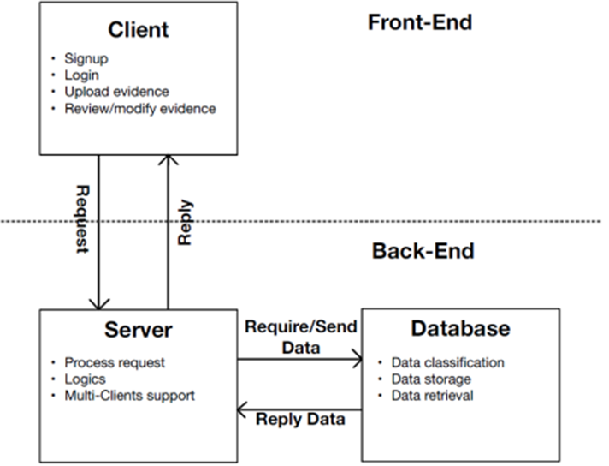
Software design pattern — Client Server

Slide 9
Graphical User Interface (GUI) vs. Web Interface
Graphical User Interface (GUI):
Pros:
More control on users’ screen
Efficiently guide users
Pop-up windows
Cons:
Low operation flexibility
Longer time for users to get familiarized
Update on user sides
Web Interface:
Pros:
Easy to access
More flexibility
Accessible to update
Cons:
Performance limited by internet
Unlimited navigation paths

Slide 10
Why Flask & Why Python?
What is Flask?
Flask is a microframework that provides basic features for a web application.
What’s the benefit of Flask + Python?
Easy to get started on and expand using Python’s libraries and extensions.

Slide 11
Technical Detail
Router Logic:
Logic codes in Server
HTML Templates:
HTML pages display to clients
Database:
Place storages data

Slide 12
Router Logic - Authentication
Login, Signup & Logout
Achieved using python library flask_login
Signup needs name, email and password
Login using email and password
Password encrypt using SHA-256 with 32 bit Salt value
SHA-256: Secure and trusted industry standard
Salt value: Avoiding same hash due to the same password
Notes:
Ref: https://blog.pagefreezer.com/sha-256-benefits-evidence-authentication

Slide 13
Router Logic - Authentication
Different User Roles and the Access Control Matrix
Access Control Method: Role-Based Access Control (RBAC)
Role/Source | Criteria | Envidence | Users
Developer | view | create, modify, delete | N/A
Administers | view, create, delete | create, modify, delete, approval | modify, delete
Quality Analyst | view | read, approval | N/A
User | N/A | N/A | N/A

Slide 14
Router Logic - Authentication
User management mechanism & Profile Management
Administers can modify other users’ account information via the admin page, modification including
Name and role change, Reset other’s password & Delete accounts
All user’s can change his/her name and password via the profile page

Slide 15
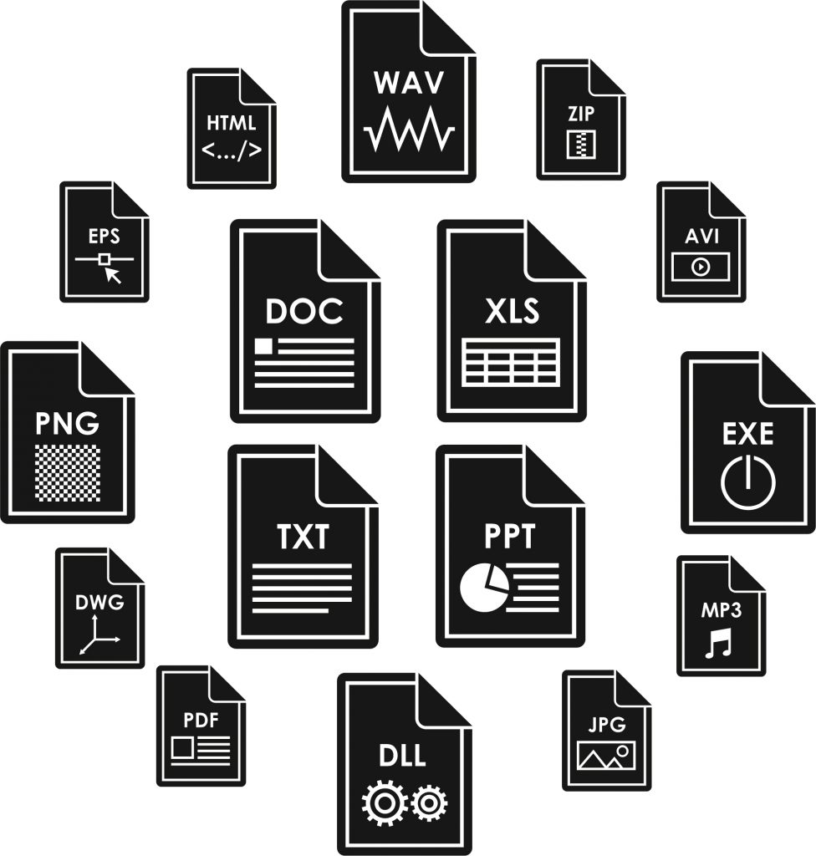
Router Logic - Evidence
Files which can be used to evaluate the security level of a system
Evidence Manage:
Upload
Search
Update
Delete
Approve

Slide 16
Upload
A notice for filling fields
Not fill required fields
Enter evidence name, project name, description (optional), choose criteria and upload evidence
A message of evidence not successfully submitted
Submit fail
Submit success
Jump to view page

Slide 17
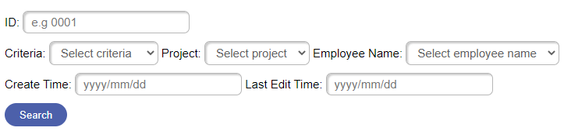
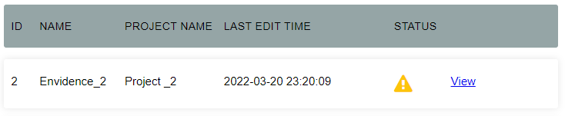
Search
Allow to search with：

Slide 18
Update
Description and evidence content

Slide 19
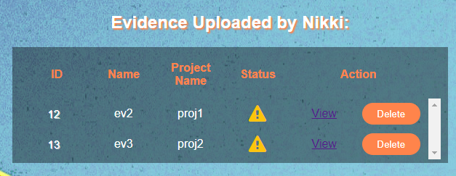
Delete
Developer and Admin could delete evidence uploaded

Slide 20



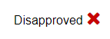
Approve

Slide 21

Router Logic - Criteria
Criteria Management
-Unique id
-Create/Delete
-Only Admin User
-Edit (name/description)

Slide 22
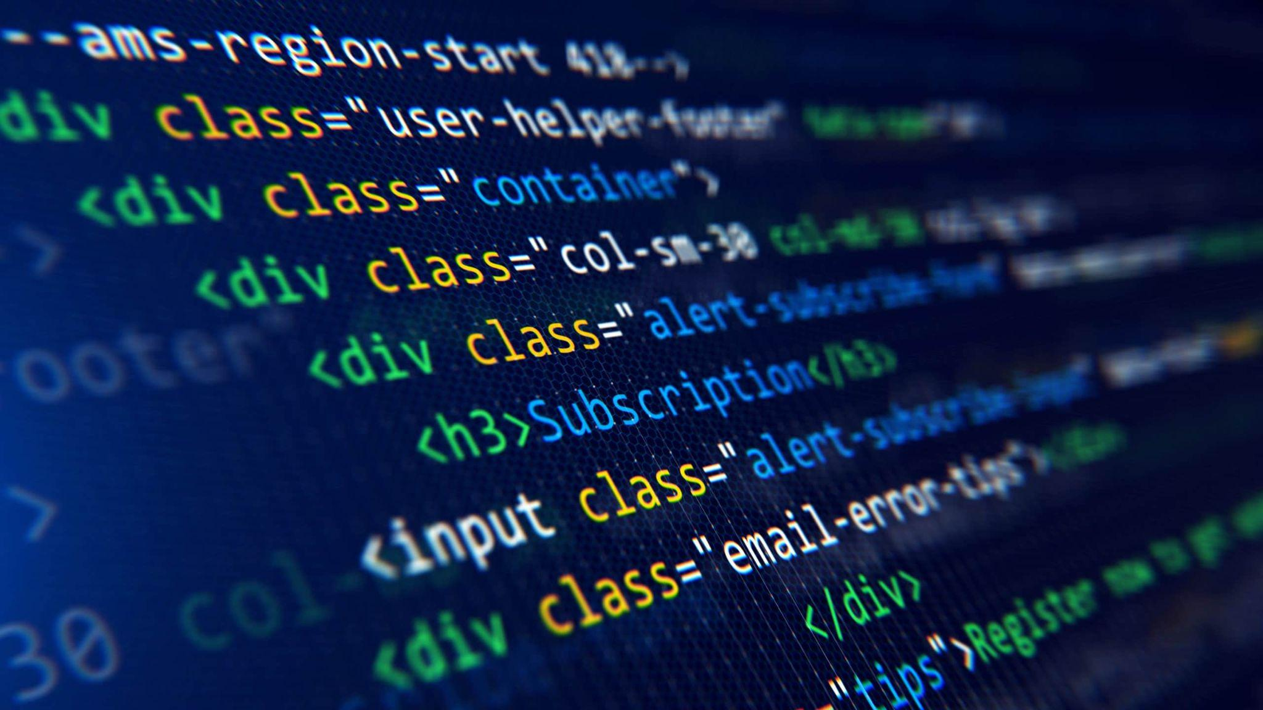
HTML Templates
Initial Pages
Evidence Related Pages
Authentication Related Pages
Criteria Management Page

Slide 23

Initial Pages
base & welcome page
base.html - Menu Bar

Slide 24
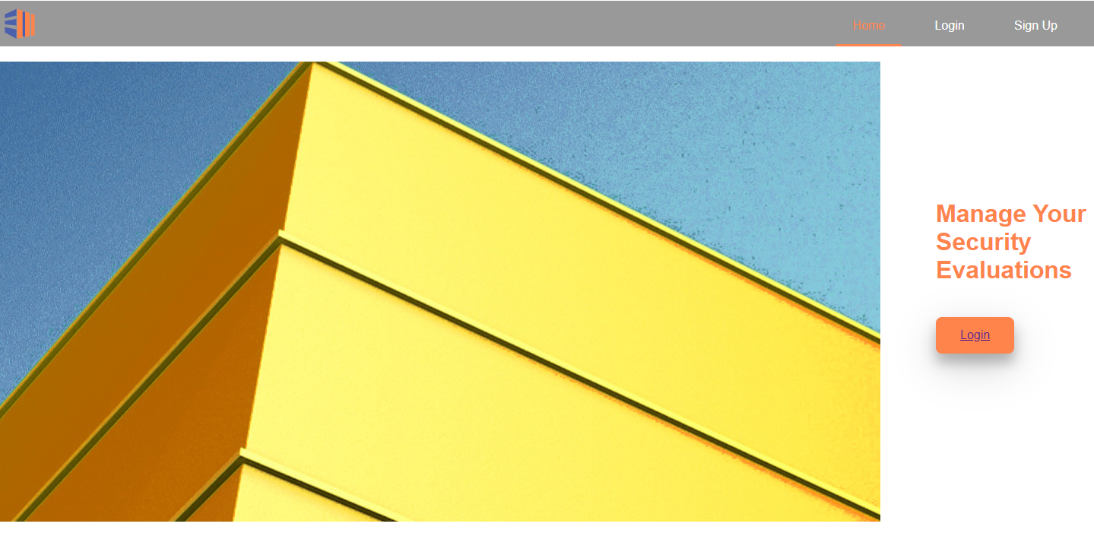
welcomePage.html - Before Login

Slide 25
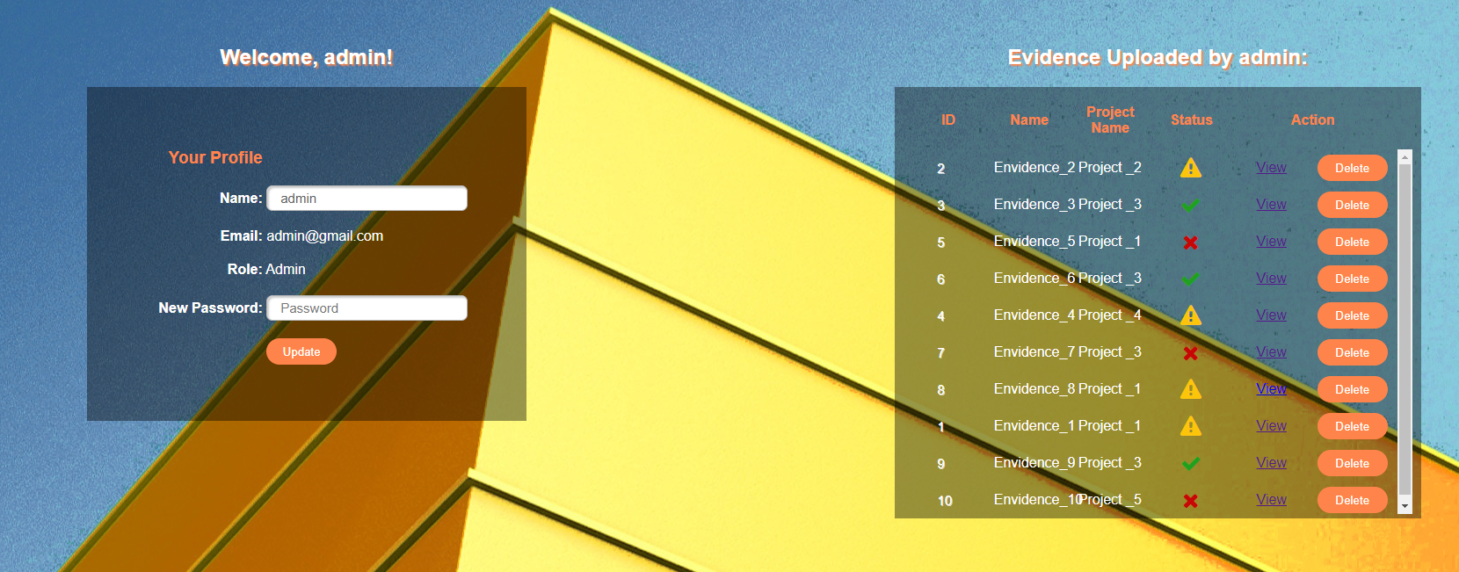
welcomePage.html - After Login

Slide 26
Evidence Related Pages
Upload.html
Search.html
View.html

Slide 27
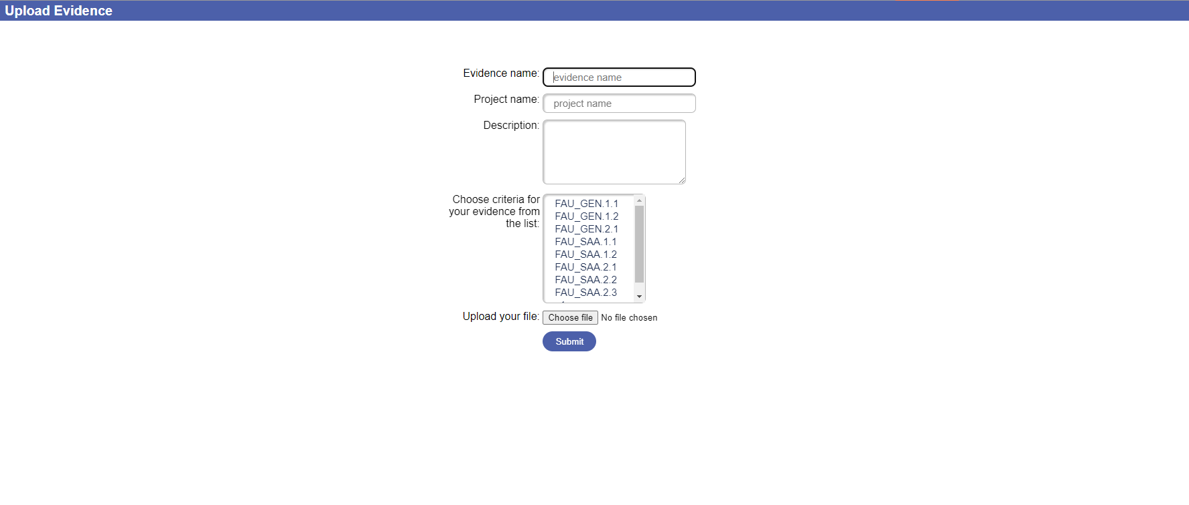
upload.html

Slide 28
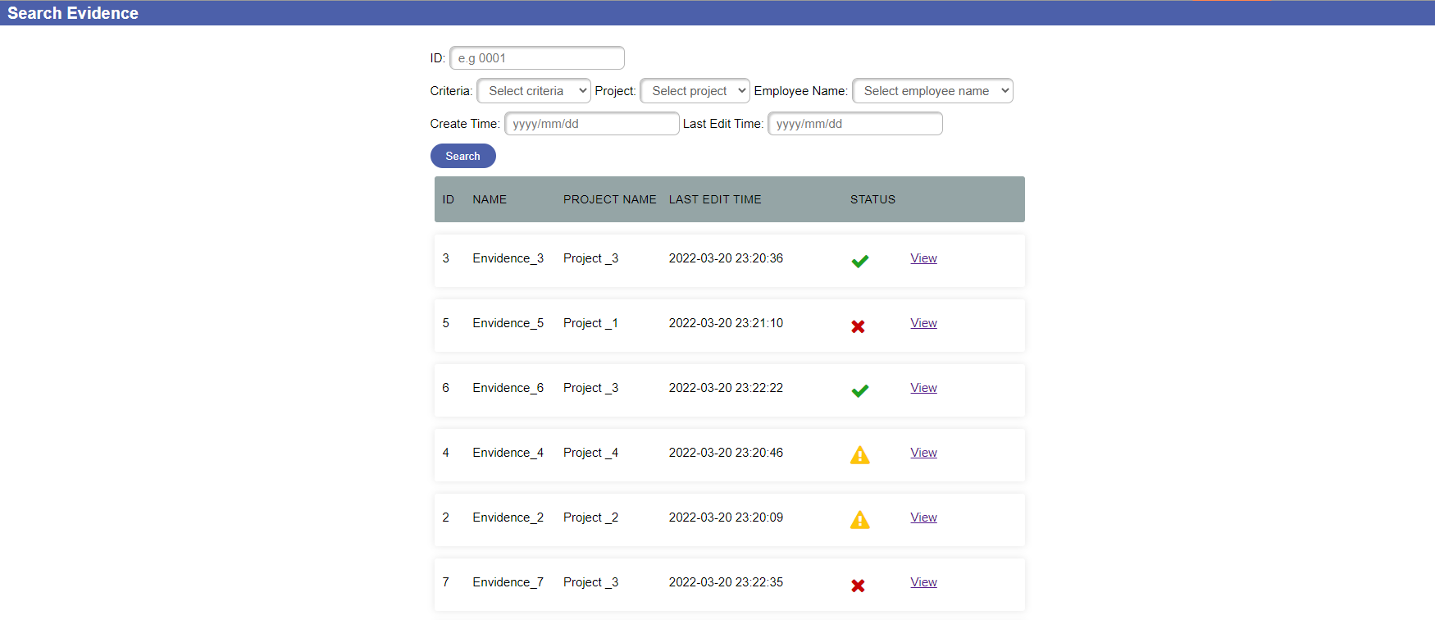
search.html

Slide 29
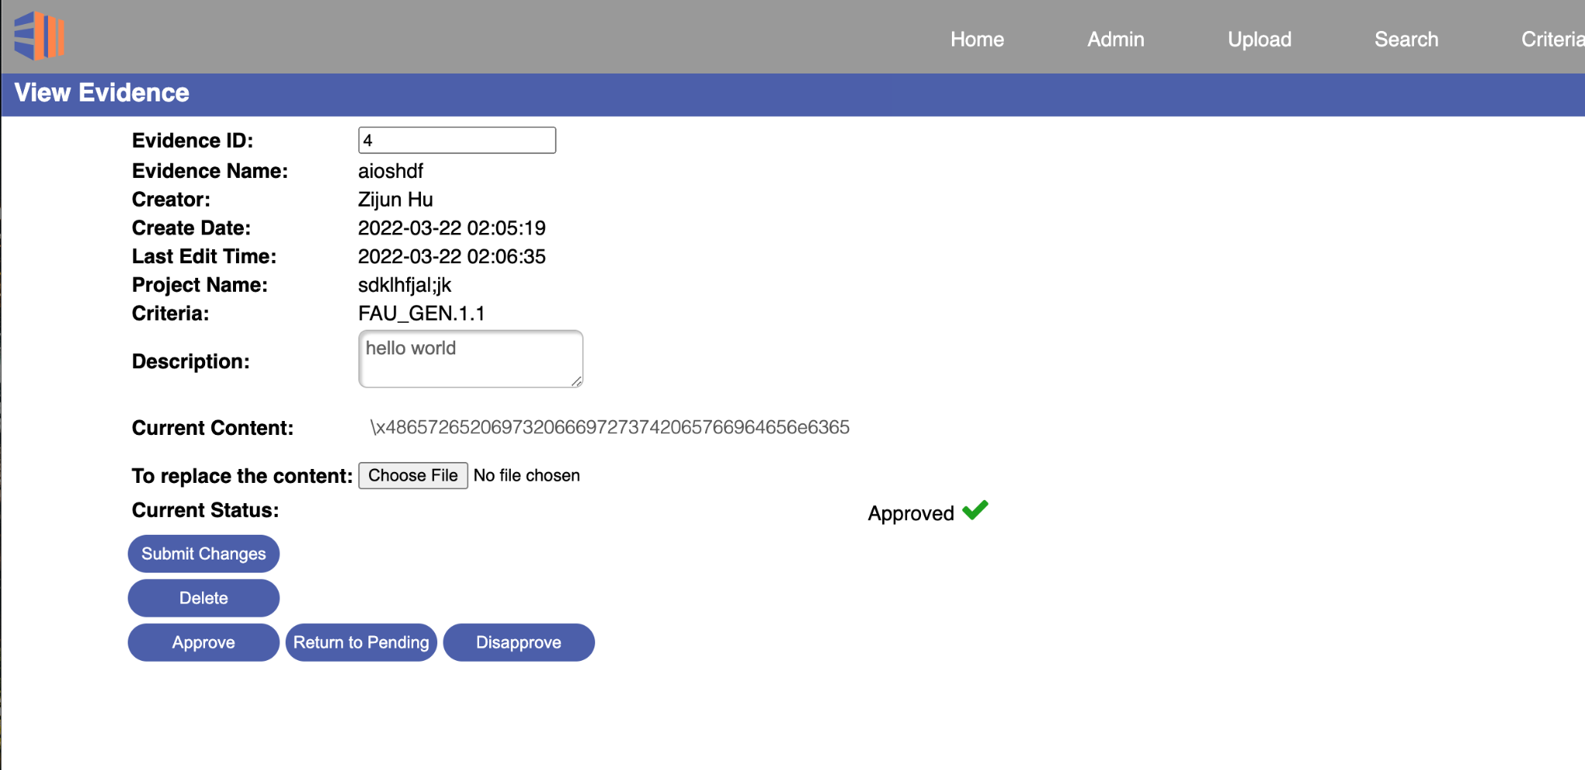
view.html

Slide 30
Authentication Related Pages
Login.html
Signup.html
Admin.html

Slide 31
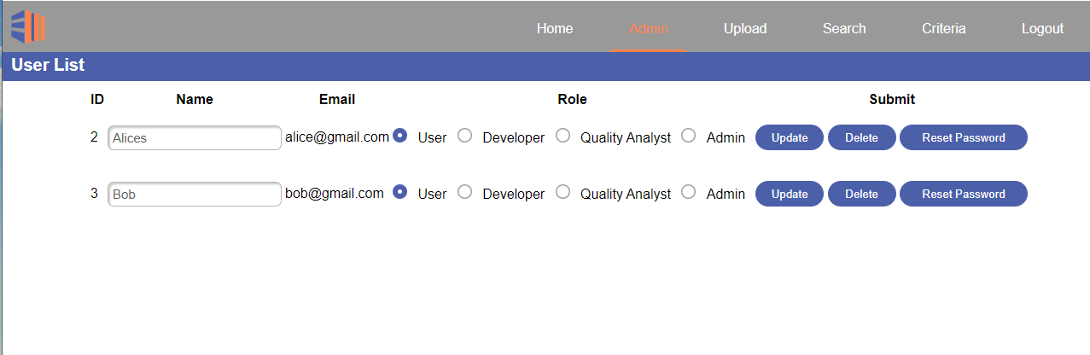
admin.html

Slide 32
Criteria Management Page
criteria.html

Slide 33
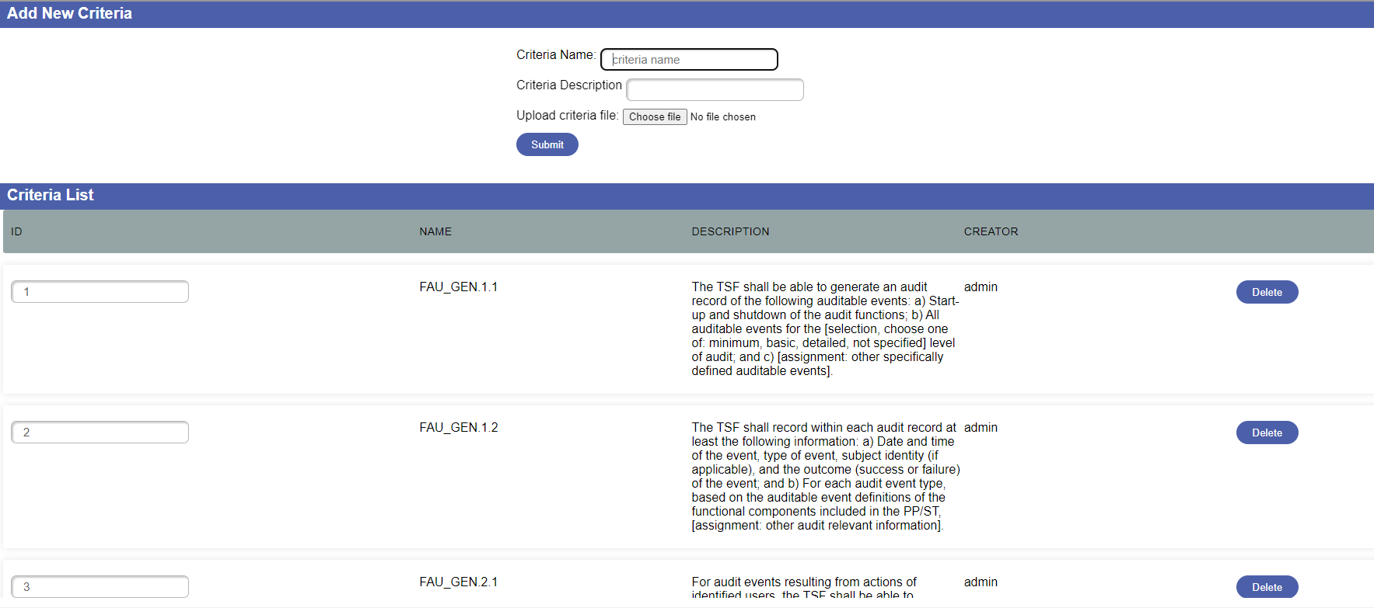
criteria.html

Slide 34
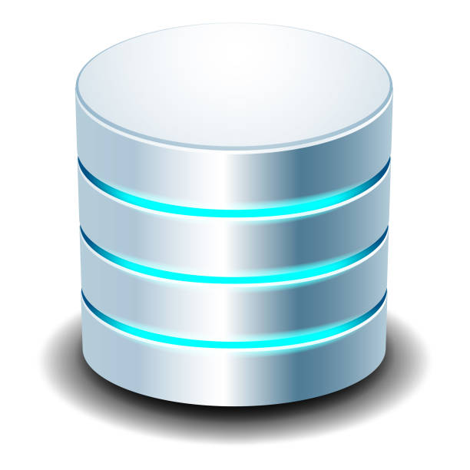
Database
Design
Plain SQL vs ORM
SQLite vs PostgreSQL

Slide 35
Database Design
Ensure Necessary Entities in Database
ER Diagram
Schema Diagram

Slide 36
Ensure Necessary Entities in Database
Entity | Mainly Usage | Purpose
User | User Login Management System | To store users’ information
Role | Access Right Control | To categorize all users and their access rights
Criteria | Categorize Evidence | Store Common Criteria information to allow users’ save evidence based on different criteria
Evidence | Store Evidence Info | Store evidence information in detail

Slide 37
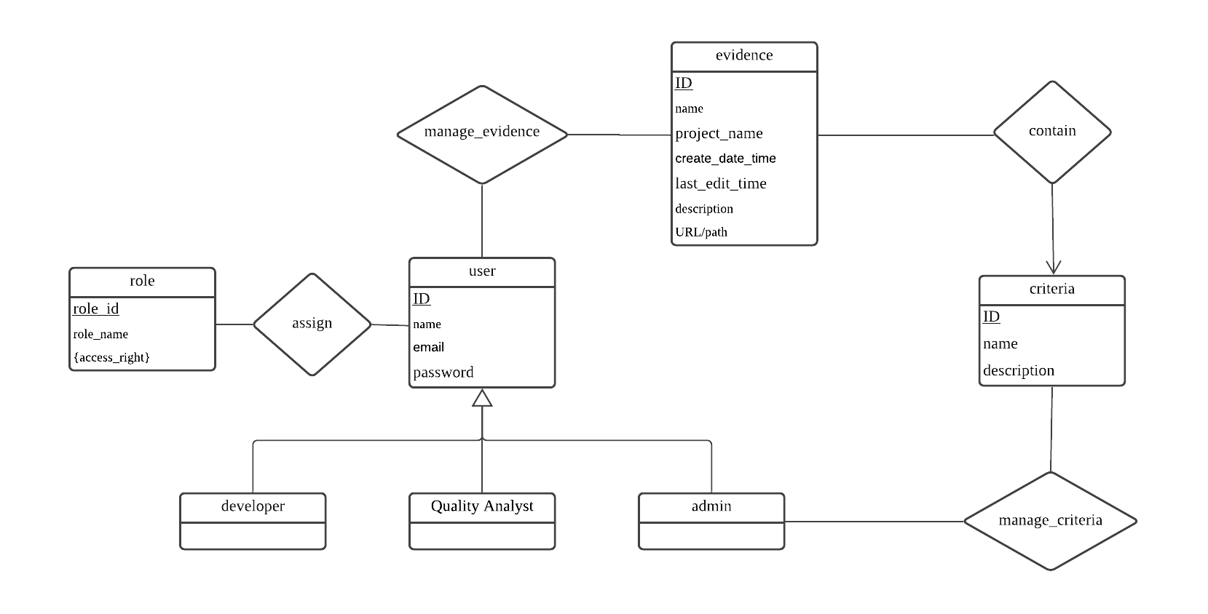
Database Design: ER Diagram

Slide 38
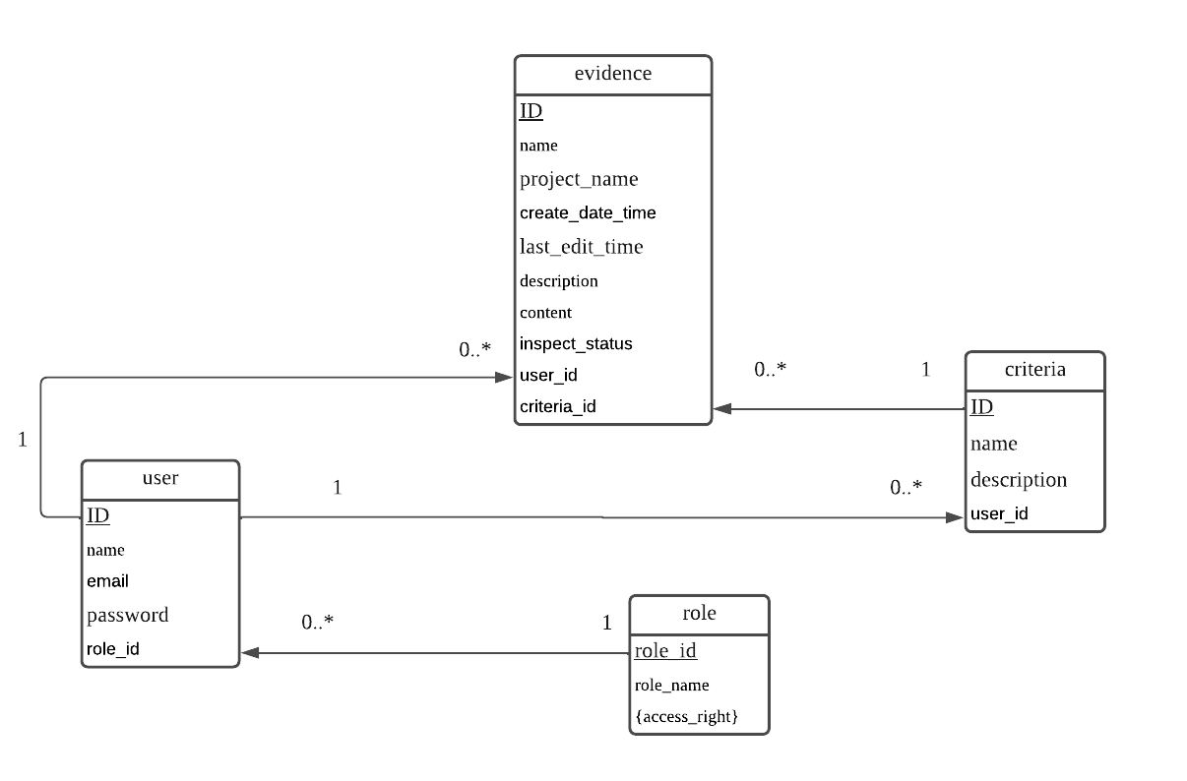
Database Design: Schema Diagram
Notes:
Make the text bigger

Slide 39
Plain SQL vs ORM
Database Tech | Plain SQL | ORM
Benefits | Fully direct Control and manage data Can handle heavy-weight data | Store Lightweight data (store, retrieve fast) Using object-oriented language (facilitate database development) Support Flask SQLAlchemy API
Defects | Does not adapt with Flask-SQLAlchemy perfectly Not adapt with Flask-Login (No solution to handle the user login system) | Cannot use raw SQL to interact with database directly (Rely on other tools e.g. SQLAlchemy) Complicate when dealing with queries with multiple tables and multiple conditions

Slide 40


SQLite vs PostgreSQL
Database Type
Server | Embedded DBMS. No server needed | PostgreSQL DBMS implements Client-Server model. Server needed to run over network.
Flask-SQLAlchemy | Supports | Supports
Data Type | Null, BLOB, Integer, Text, Real | All types of data
Multiple Users Access | Not well | Very well
Speed | Fast | Slow, because of the powerful DBMS
Security | Less secure. Anyone who can access database can update data | More secure Has identity verification system.
Heroku | Not support | Support

Slide 41





Deploy to Cloud
Database
Server

Slide 42
Heroku： FREE Cloud Service Provider!!
Reliable: Runs on Amazon Web Services (AWS)
Has Heroku Postgres tool to make database available for online service
Provide the online service at anytime and anywhere for all users
Connect to the GitHub Repository
Has continuous integration and delivery pipelines (CI/CD)
Access Website through URL: https://security-evaluation.herokuapp.com/

Slide 43
DEMO

Slide 44
Conclusion - Accomplishment
Achieved evidence storage and management
Achieved managing the system access based on roles including: Developer, Quality Analyst / Inspector, Administrator
Achieved users, evidence and criteria management, and evidence approval
Achieved upload criteria in batches by uploading the Common Criteria file (CSV format)
Deployed project to cloud

Slide 45
Conclusion - Possible Extension
To support all format of evidence files. (Only supports txt file)
Add evidence download feature. (Only online review)
Add the evidence update or modify history/rollback.
Deploy the system to a more stable server

Slide 46
References
[1] F. Churchville, "What Is a User Interface?," TechTarget, September 2021. [Online]. Available: https://searchapparchitecture.techtarget.com/definition/user-interface-UI. [Accessed 21 October 2021].
[2]J. Nielsen, "The Difference Between Web Design and GUI Design," Nielsen Norman Group, 30 April 1997. [Online]. Available: https://www.nngroup.com/articles/the-difference-between-web-design-and-gui-design/. [Accessed 1 October 2021].
[3] Olga, “Flask Python framework,” Quintagroup, 29-Nov-2018. [Online]. Available: https://quintagroup.com/cms/python/flask. [Accessed: 21-Mar-2022].
[4] A. Stempniak and W. Semik, Flask vs. Django: Which Python Framework Is Better for Your Web Development?[Online]. Available: https://www.stxnext.com/blog/flask-vs-django-comparison/.

Slide 47
References
[5] P. Callaghan, Why You Should Use SHA-256 in Evidence Authentication.
[6] N. Samuel, “SQLite VS postgresql: 8 critical differences - learn,” 18-May-2021. [Online]. Available: https://hevodata.com/learn/sqlite-vs-postgresql/ . [Accessed: 15-Mar-2022].
[7] S. Rostad, “What is Heroku? A simple explanation for Non-Techies," TriFin Labs, 22-Jun-2018. [Online]. Available: https://trifinlabs.com/what-isheroku/ .[Accessed: 15-Mar-2022].

Slide 48
Questions?

